Slide 1
Rock and Heavy Metal Music

Slide 2
History
Kickoff - late 60’s
Mainstream – 70’s
Golden age – 80’s and 90’s
Downhill – after 2000
Notes:
1st metal band – Black Sabbath, British Metal – Iron Maiden, Motorhead, Deep Purple, Queen

Slide 3
Characteristics
Vocalist, (Electric)Guitars, Bass and Drums
Loud and Powerful
Dark Lyrics?
Every Metal Genre in a Nutshell
Notes:
Aggressive/Vigorous Vocal, Distorted Guitars, Riffs, Dense Bass and Drum

Slide 4
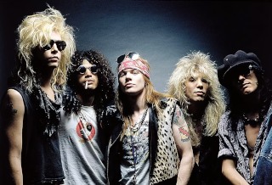
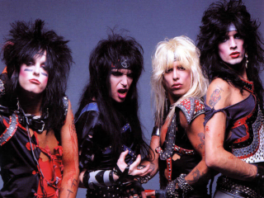
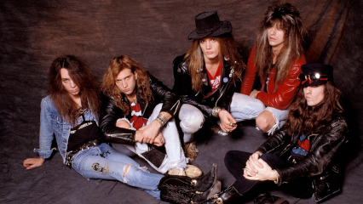
Sub-genres
Hair/Pop Metal
Notes:
Motley Crue, Poison, Skid Row

Slide 5
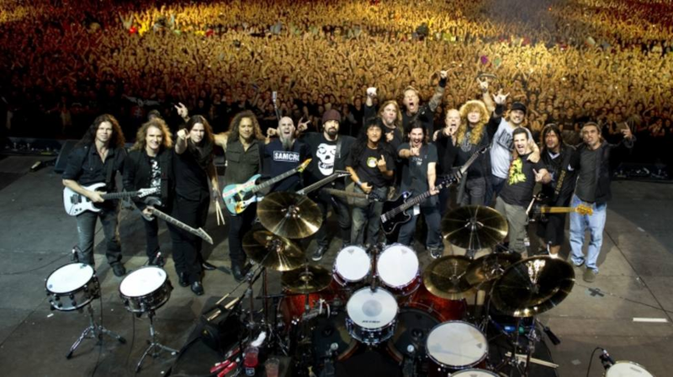
Sub-genres
Thrash/Speed Metal
“Big Four”
Notes:
Metallica, Megadeth, Slayer, Anthrax

Slide 6
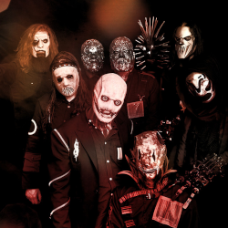
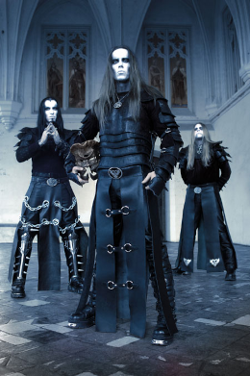
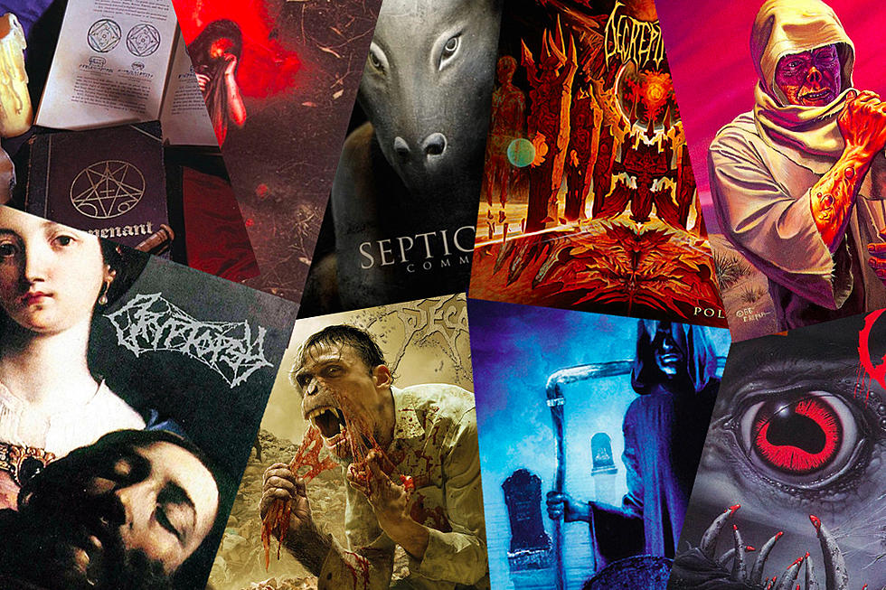
Sub-genres
Others
Black/Death Metal

Slide 7



Sub-genres
Others
Alternative
Punk
…
Notes:
Nirvana, Red Hot Chili Peppers, Pearl Jam

Slide 8

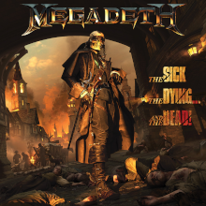
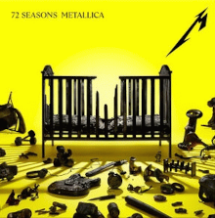

Latest News

Slide 9





Quiz
What’s the hand sign
A
B
C
D

Slide 10
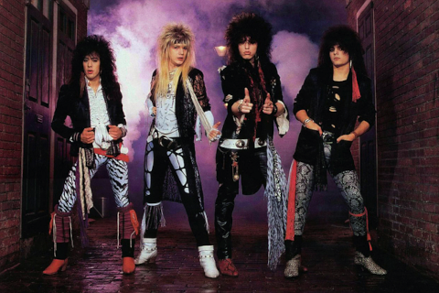

Quiz
Which genre of this band
A - Death Metal
B - Punk Metal
C - Thrash Metal
D - Hair Metal

